Slide 1
Dragon Quiz -
Brandin Bulicki - Dennis Lougharn -
Isaiah Noble - Briana Schuetz

Slide 2
Project Overview
Dragon Quiz is a trivia-based game in which users will answer questions from a variety of categories and compete with friends to gain the most points. Users can test their general knowledge on a variety of categories and accumulate points from correctly answering questions. The top earners will be displayed on a leaderboard.

Slide 3
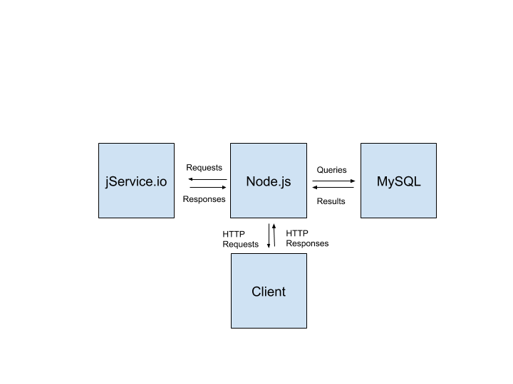
Technologies Used
Information Flow Diagram
API: jService.io
Database: MySQL
Server: Node.js
User
_________________
Username
Total Points
Password

Slide 4
Use Cases
Can use it for icebreakers at parties and events.
Test yourself at general knowledge.
Try to make your mark on the leaderboard.
Good time killing activity.
See how much of an expert you are at a topic

Slide 5
Main Features
User profile (Name, Score)
A variety of question categories (Sports, History, Technology, etc.)
Leaderboard to display the top 10 point earners

Slide 6
Looking forward . . .
Implement multiple-choice feature
Further account security
Profile options (avatar / profile picture)
Weekly points leaderboard
Chat feature

Slide 7
Demo . . .

Slide 8
Questions?

